Slide 1
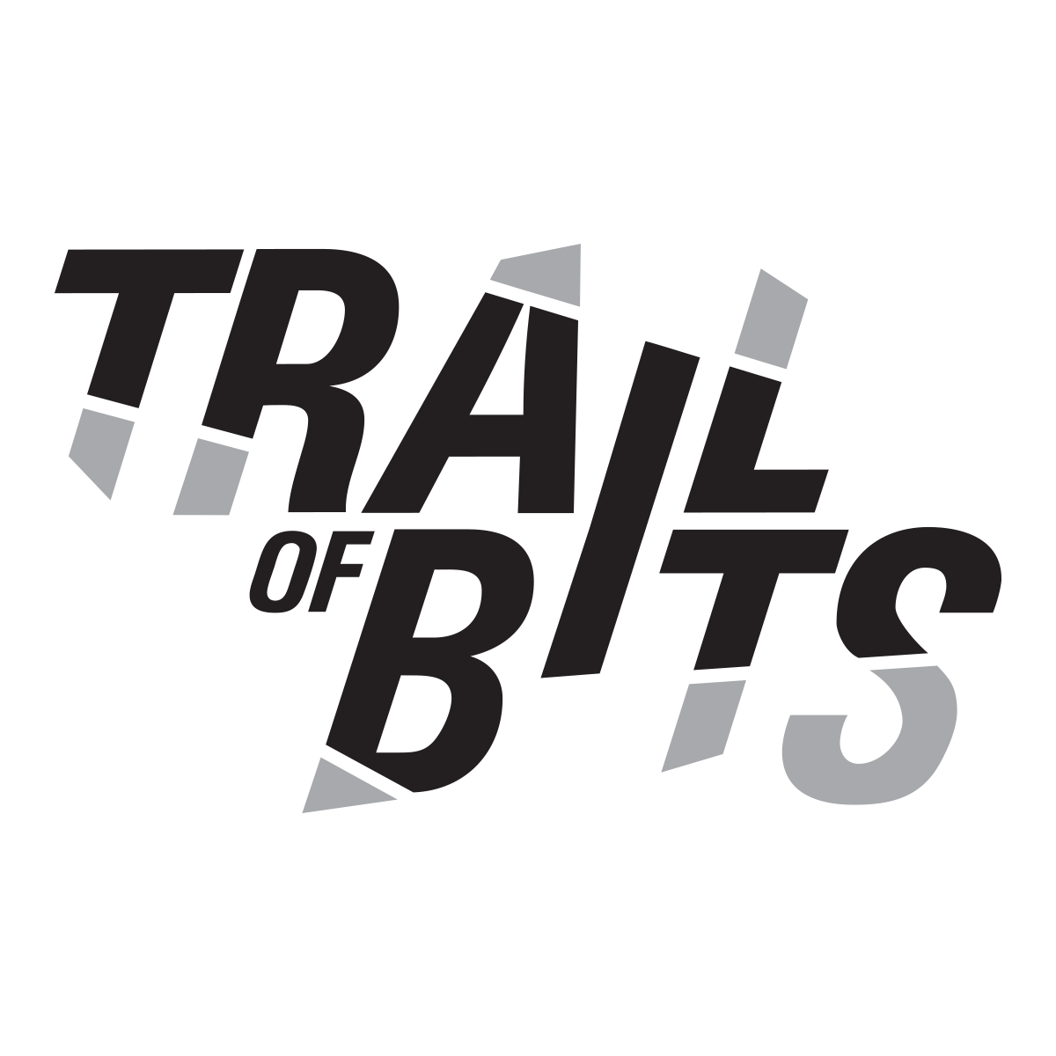

Improving Reproducibility
in Smart Contract Research
(Master thesis defense)
Sina Pilehchiha
Supervised by:
Dr. Amir Aghdam
Dr. Jeremy Clark
Department of Electrical and Computer Engineering
Faculty of Engineering and Computer Science
Concordia University
June 2022
Notes:
Good Afternoon. My name is Sina Pilehchiha, a MASc student at the ECE department, supervised by Profs. Aghdam and Clark.
Welcome to my Master thesis defense.
This thesis has been completed with partial work done at Trail of Bits, Inc.

Slide 2
Publications
Improving Reproducibility in Smart Contract Research
Pilehchiha, S., Aghdam, A., & Clark, J. (2023, January). Improving Reproducibility in Smart Contract Research. In WTSC Workshop, co-located with International Conference on Financial Cryptography and Data Security.
Notes:
The main contribution of this thesis concerns this paper which is queued to be submitted to the WTSC workshop 2023, written by me, and my both co-supervisors.

Slide 3
Outline
Introduction
Notes:
The outline of this presentation is comprised of four main parts.
First, I’ll go through introducing some of the preliminary concepts concerning blockchain technology, Ethereum, smart contracts, and code similarity.

Slide 4
Outline
Introduction
Code Similarity in Solidity
Notes:
Second, I’ll be talking about the tool I developed during my internship at Trail of Bits, Inc. `Slither-simil`, which helps auditors find similar vulnerabilities or code snippets in Solidity source code.

Slide 5
Outline
Introduction
Code Similarity in Solidity
Reproducibility in Smart Contract Research
Notes:
Third, I’ll be discussing EtherBase, the main contribution in this thesis, a representative database of Solidity smart contracts to help researchers with their evaluation efforts and reproducibility experiments.

Slide 6
Outline
Introduction
Code similarity in Solidity
Reproducibility in Smart Contract research
Conclusion & future work
Notes:
Finally, I will briefly go over conclusion and future work concerning this research.

Slide 7
INTRODUCTION
Dealing with smart contract insecurities
Notes:
In this part of the talk, I will go over some introductory concepts such as blockchain technology, Ethereum blockchain, smart contracts and their security issues, and then focus on the immutability of smart contracts, how the Ethereum community has been dealing with them, and how we are going to contribute to the stack of solutions for the purpose of increasing the security of Ethereum smart contracts.

Slide 8
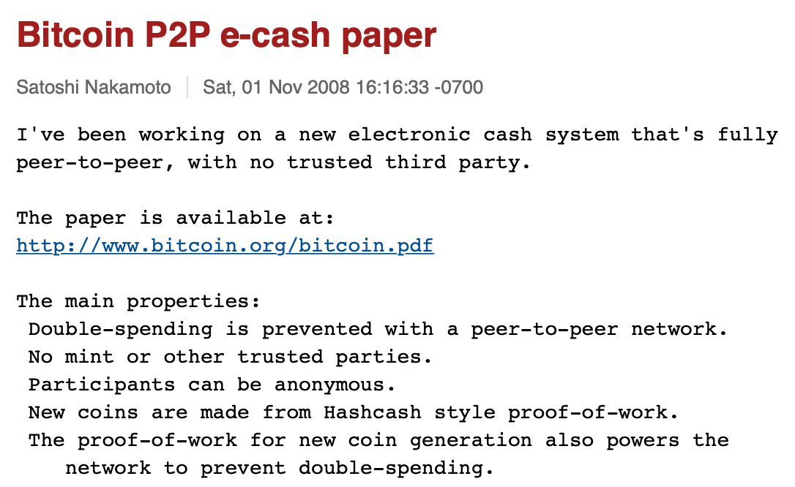
Bitcoin: Birth of (Public) Blockchain
Notes:
Alright; let’s start by answering the question : What is a blockchain, exactly?
To answer this, we need to go back to Nov 1st, 2008, when the famous and anonymous Satoshi Nakamoto released their Bitcoin whitepaper.
This ushered the world into a new era for public blockchains.

Slide 9
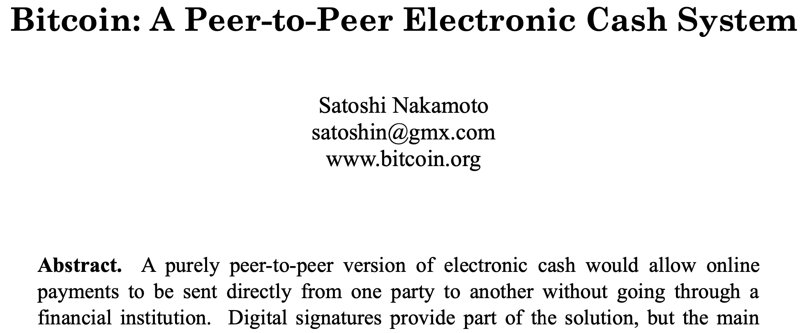
Bitcoin: Birth of (Public) Blockchain
Notes:
Public blockchains are also called distributed ledgers.
They are a new type of technology that enables mutually distrusted nodes to come together and collectively maintain an immutable ledger that’s open to anyone and that maintains immutable records and transactions.

Slide 10
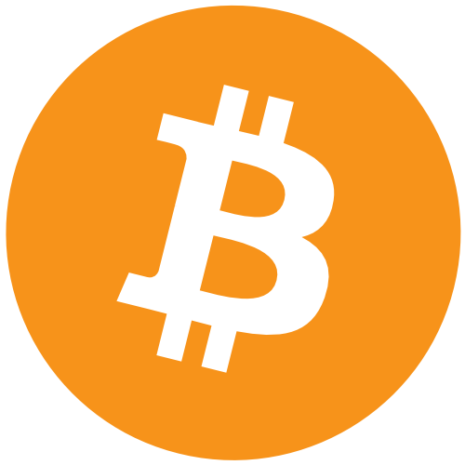
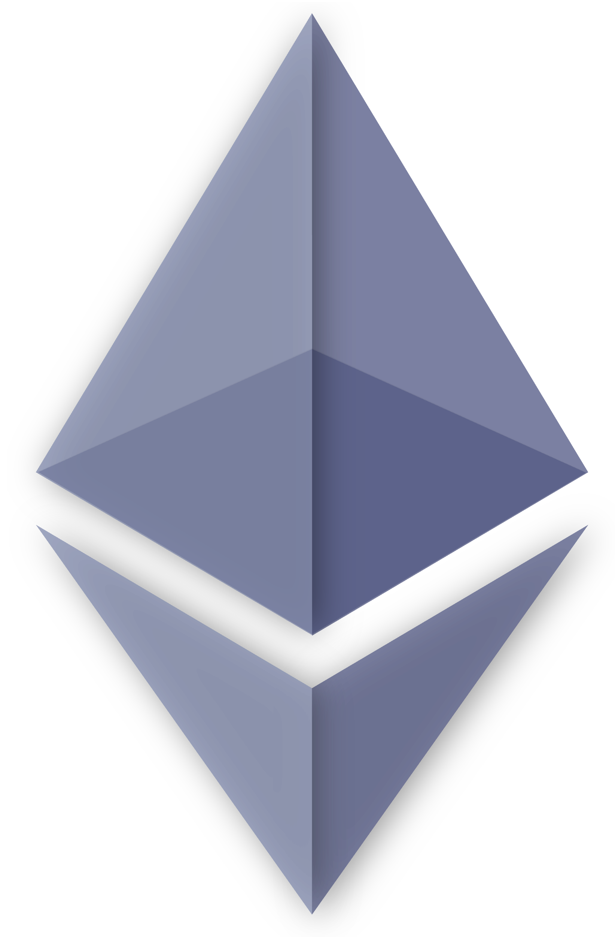
Ethereum: Birth of Smart Contract Platform
Programmable money
&
Financial assets
Self-custody of money
Notes:
With the birth of Bitcoin, it provided for the first time, the capability for users to provide self-custody for money in a particular digital currency.
In 2014, Ethereum was proposed as a next-generation blockchain platform, in particular, a smart contract platform with a Turing-complete smart contract language.
With Ethereum, it allows different types of applications to run on top of the smart contract platform and hence provides the capabilities for the first time for open programmable money and financial assets.

Slide 11
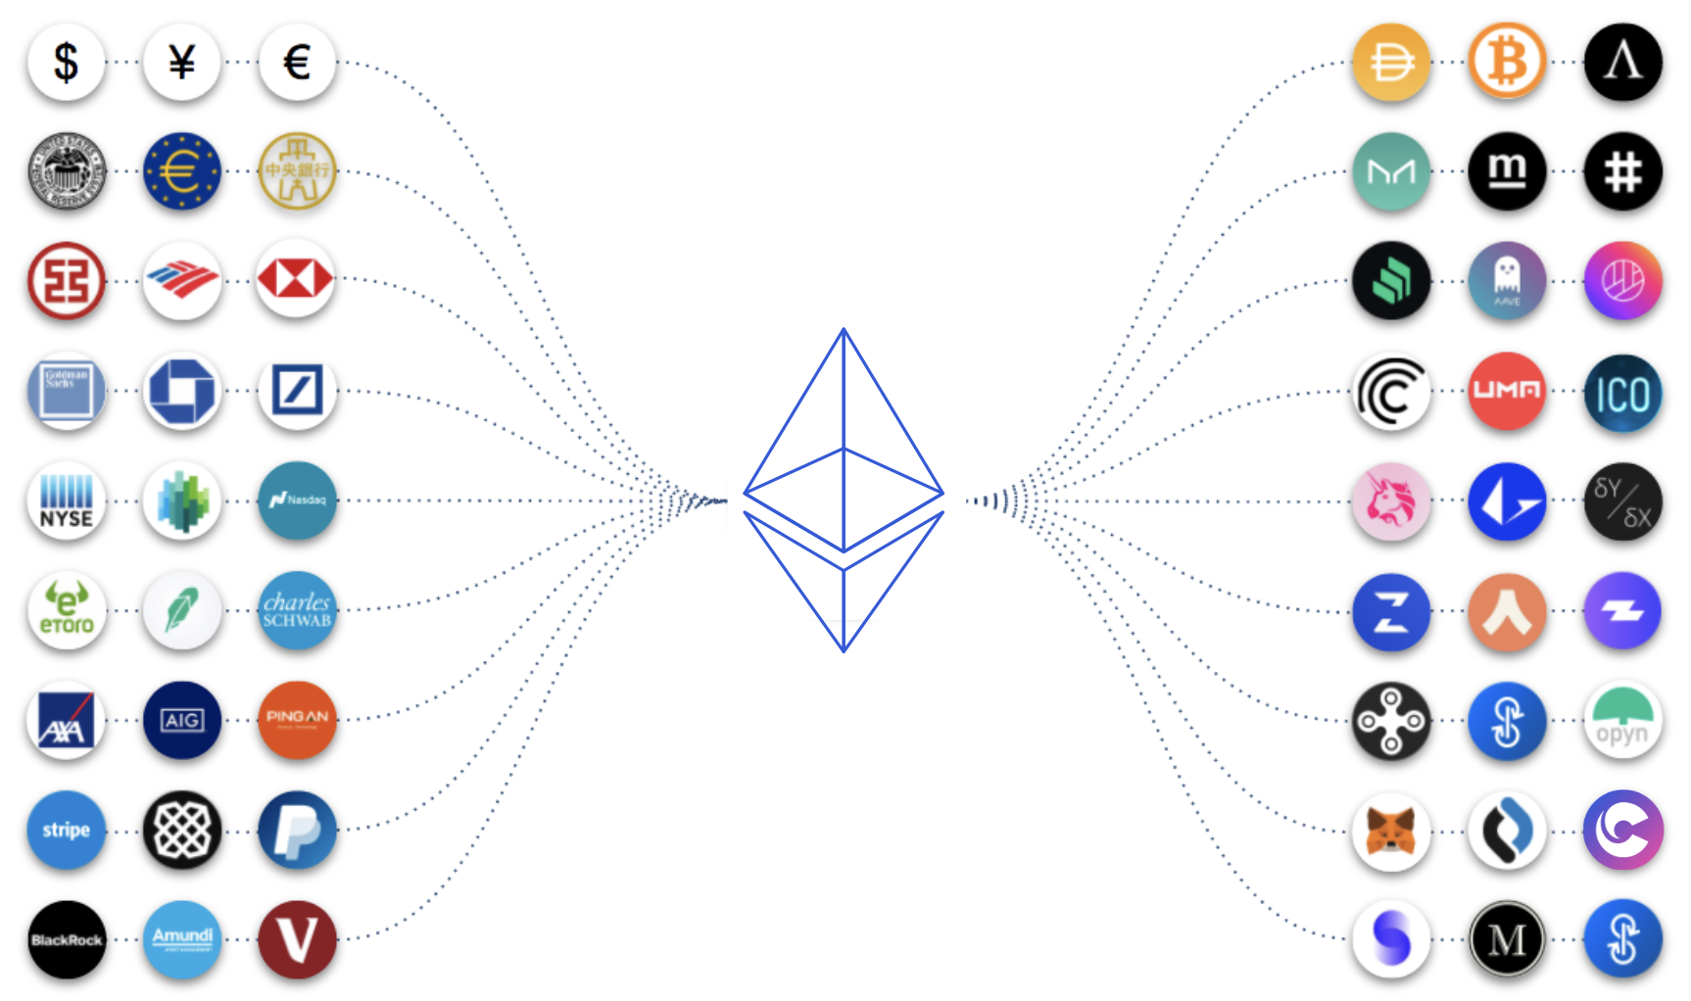
What is Decentralized Finance (DeFi)?
Image credit: Consensys Codefi
Notes:
And this essentially enabled a new way of doing financials services, called DeFi or Decentralized Finance, the most popular application of the blockchain technology to date.
So what is Decentralized Finance?
This is essentially a new type of financial infrastructure that is open, permissionless, and highly interoperable protocol stack built on top of public smart contract platforms.

Slide 12
Smart Contracts
Piece of code run on blockchain
Notes:
This gets us back to the Ethereum blockchain and its innovative contribution, namely, smart contracts.
What are they exactly?
A smart contract is basically a code that resides on the Ethereum blockchain network…

Slide 13
Smart Contracts
Piece of code run on blockchain
With predetermined execution conditions
Notes:
This gets us back to the Ethereum blockchain and its innovative contribution, namely, smart contracts.
What are they exactly?
A smart contract is basically a code that resides on the Ethereum blockchain network… and executes when predetermined conditions get satisfied.

Slide 14
Smart Contracts
Piece of code run on blockchain
With predetermined execution conditions
Millions of smart contracts deployed on Ethereum
Notes:
They are programs that run atop of a financial infrastructure, and command the flow of money according to user-defined rules.
The Ethereum blockchain already hosts tens of millions of smart contract programs deployed by users.

Slide 15
Smart Contracts
Piece of code run on blockchain
With predetermined execution conditions
Millions of smart contracts deployed on Ethereum
Millions of USD in asset value
Notes:
These smart contracts on Ethereum handle financial assets worth millions of U.S. Dollars (USD).

Slide 16
Smart Contracts
Piece of code run on blockchain
With predetermined execution conditions
Millions of smart contracts deployed on Ethereum
Millions of USD in asset value
Turing-complete language capabilities
Notes:
In cryptocurrencies like Ethereum, smart contracts give end users the full power and expressivity of a Turing-complete language.

Slide 17
Smart Contracts
Piece of code run on blockchain
With predetermined execution conditions
Millions of smart contracts deployed on Ethereum
Millions of USD in asset value
Turing-complete language capabilities
Programmable money
Notes:
Smart contracts are appealing for many reasons, and provide great potential.
They essentially provide users with “programmable money” that can be used to automatically enforce agreements between potentially distrusting parties.

Slide 18
Smart Contracts
Piece of code run on blockchain
With predetermined execution conditions
Millions of smart contracts deployed on Ethereum
Millions of USD in asset value
Turing-complete language capabilities
Programmable money
Security vulnerabilities
Notes:
With such great power can come equally devastating bugs with direct financial consequences.
Furthermore, since smart contracts are tied directly to anonymous payment instruments, they are an attractive target for hackers.

Slide 19
Smart Contracts
Piece of code run on blockchain
With predetermined execution conditions
Millions of smart contracts deployed on Ethereum
Millions of USD in asset value
Turing-complete language capabilities
Programmable money
Security vulnerabilities
TheDAO (USD $60 mm)
Parity Wallet (USD 6.1 mm)
Notes:
Recent high-profile disasters involving the TheDAO and the Parity Wallet have highlighted these risks.
Attackers have exploited programming bugs to steal more than approximately $70M USD.

Slide 20
Security Vulnerabilities
Code is Law
Notes:
As the blockchain is an immutable ledger and irreversible by nature, when developers deploy a vulnerable smart contract on the blockchain, the developers neither can fix the contract’s code nor interrupt the execution of the contract.

Slide 21
Security Vulnerabilities
Code is Law
Static analysis methods
Notes:
Therefore, detecting smart contract vulnerabilities has become a vital and immense challenge to solve urgently.
Most of the current smart contract vulnerability detection approaches use static analysis to search vulnerability patterns pre-defined by experts in target smart contracts.

Slide 22
Security Vulnerabilities
Code is Law
Static analysis methods
Manually defined patterns
False negatives
Notes:
These manually defined vulnerability patterns are relatively simple and cannot cover some complex vulnerability patterns, which will cause a high rate of false negatives.
Moreover, with the rapid growth of smart contracts, it has become challenging to design precise vulnerability patterns through a few experts
With the high stakes in smart contracts and race between attackers and defenders, it can be far too slow and costly to write new rules and construct new checkers in response to new bugs and exploits created by attackers.

Slide 23
Security Vulnerabilities
Code is Law
Static analysis methods
Manually defined patterns
False negatives
Machine-learning-based approaches
Notes:
We aim to enable efficient checking of smart contracts and can evolve checking rules along with the evolution of code and/or bugs, based on our deep learning model for smart contracts.

Slide 24
ML Methods for Vuln. Detection
Feature Engineering for Smart Contractsa
Static analysis methods
Manually defined patterns
False negatives
Machine-learning-based approaches
Notes:
We aim to enable efficient checking of smart contracts and can evolve checking rules along with the evolution of code and/or bugs, based on our deep learning model for smart contracts.

Slide 25
Security Vulnerabilities
Code is Law
Static analysis methods
Manually defined patterns
False negatives
Machine-learning-based approaches
Notes:
We aim to enable efficient checking of smart contracts and can evolve checking rules along with the evolution of code and/or bugs, based on our deep learning model for smart contracts.

Slide 26
Slither-simil
Development of a statistical tool to aid auditors
Notes:
Trail of Bits, Inc. as a top-tier software security company set out to test this idea of a statistical approach to vulnerability detection in Solidity to:

Slide 27
Slither-simil
Development of a statistical tool to aid auditors
Minimize the risk of recurring human error
Notes:
Minimize the risk of recurring human error, i.e., the chance of overlooking known, recorded vulnerabilities, and

Slide 28
Slither-simil
Development of a statistical tool to aid auditors
Minimize the risk of recurring human error
Lower the false positive rate
Notes:
Minimize the risk of recurring human error, i.e., the chance of overlooking known, recorded vulnerabilities, and
Help human auditors sift through potential vulnerabilities faster and more easily while decreasing the rate of false positives

Slide 29
Slither-simil
Development of a statistical tool to aid auditors
Minimize the risk of recurring human error
Lower the false positive rate
First-ever statistical addition to Slither
Notes:
Slither-simil, the statistical addition to Slither, is a code similarity measurement tool that uses SOTA machine learning to detect similar Solidity functions.

Slide 30
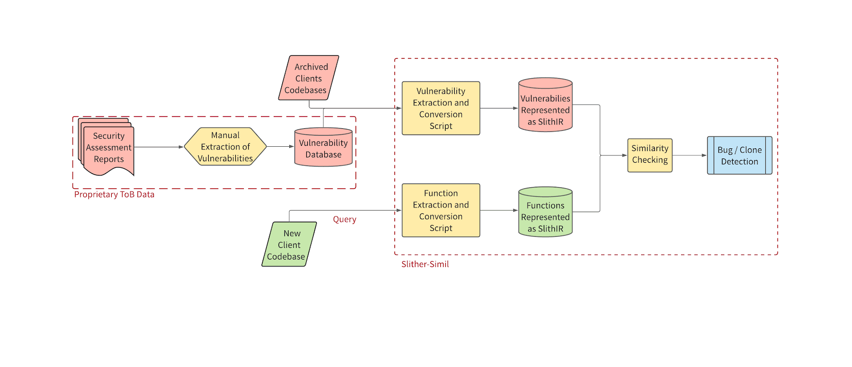
Slither-simil

Slide 31
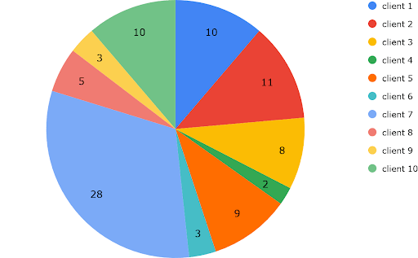
Slither-simil

Slide 32
RELATED WORK
Various Analysis Approaches for Solidity
Notes:
In this section, I describe related works in terms of security analysis of Ethereum smart contracts by machine learning.

Slide 33
Security Analysis of Ethereum by ML
Piece of code run on blockchain
Inherits properties of blockchain (e.g., immutability)
Differences between smart contracts (WEB3) and traditional codes (WEB2)
Notes:
As machine learning-based analysis, ContractWard and the tool by Momeni et al. are based on support vector machine (SVM) and random forest, whose features are extracted manually by an analyst. Hence, identifiable vulnerabilities are limited due to insufficient feature extraction.
As research on automated feature extraction, VulDeeSmartContract has been proposed by combining Word2Vec with long-short term memory (LSTM), but it specializes only in re-entrancy vulnerability. Eth2Vec can be considered as a tool dealing with more versatile vulnerabilities in a similar approach.
Next, EClone [24] is a tool that detects code clones of Ethereum smart contracts through the computation of code similarity. Although EClone does not utilize neural networks, a symbolic analysis tool suitable for vector computations of codes has also been proposed. The detectability of Eth2Vec can be improved potentially by combining it with EClone.
In the neural network-based approach, there is ILF [17] which automatically generates an input of fuzzing test via neural networks. Loosely speaking, ILF learns codes by ex- tracting features via symbolic execution. Since ILF learns outputs by symbolic execution, it is an entirely different tool from Eth2Vec, which learns codes themselves.
Finally, SmartEmbed [14] is a tool that identifies bugs of smart contract codes by leveraging FastText, which represents the codes as vectors. SmartEmbed is the closest work to Eth2Vec. However, SmartEmbed did not discuss an objective function and training algorithm explicitly and just vectorizes codes in accordance with Word2Vec and FastText. Conse- quently, there are several code samples which are unidentified as clones, as shown in the paper [14]7. In contrast, Eth2Vec can precisely extract features of codes with a vast vocabulary and thus can detect vulnerabilities even after codes are rewrit- ten. Nevertheless, SmartEmbed is an elegant work that also discussed code repairing as well as versatile bugs. Interested readers are advised to read the SmartEmbed paper.

Slide 34
Reproducibility Issues
Various Tools
Mythril, Slither, Oyente, Maian, SmartCheck
Ren et al.
Durieux et al.
Notes:
To detect the attacks on Ethereum smart contracts, the Ethereum community has developed plenty of tools as we saw in the previous slides.
These tools analyze smart contracts and produce vulnerability reports.
The authors of these tools use datasets of smart contracts to evaluate the tools’ efficiency, correctness, and other parameters.
However, datasets used by the authors to evaluate their tools vary significantly.
The type of dataset has an impact on the tool’s performance.
Therefore it is necessary to evaluate tools using multi-type integrated benchmark suite.
Ren et al. have created a dataset having has two types of smart contracts: annotated and non-annotated.
However, the number of annotated smart contracts in the database is very small (less than a thousand).
Further, most of these annotated smart contracts not real-world contracts.
The dataset created by Ferreira et al. the same issues.
Hence, these datasets cannot be considered representatives for the real-world Ethereum smart contracts.
There is a need for a benchmark suite containing real world smart contracts labelled with vulnerabilities.
Ren et al. crafted a benchmark suite that integrates labeled and unlabeled Smart Contracts.
The unlabeled dataset has 45,622 Real-World Ethereum Smart Contracts having more than one transaction on the Ethereum blockchain.
The labeled dataset has artificially constructed contracts (350 contracts) and confirmed vulnerable contracts (214 contracts).
Durieux et al. crafted a dataset of annotated and non-annotated smart contracts.
The annotated part contains 69 contracts tagged with 115 vulnerabilities.
The annotated part has ten categories of vulnerabilities. In contrast, the non annotated part contains 47,518 unique contracts, each with at least one transaction on the Ethereum network.
Researchers can’t use the unlabeled dataset to evaluate the tool as there is no ground truth associated with it. Moreover, the labeled dataset doesn’t have more than a thousand smart contracts.
Many vulnerability analysis tools used unlabeled datasets to evaluate the tool. Due to huge number of contracts in these datasets, either the dataset is not annotated or a very small subset is annotated with the vulnerabilities present. To the best of our knowledge, there is no fully annotated dataset released publicly.
Smartcheck authors evaluate the tool’s accuracy by using three annotated smart contracts.
These annotated smart contracts do not represent the diverse smart contracts from Ethereum.
Moreover, the authors used 4,600 verified contracts from Ethereum to evaluate the tool’s efficiency. However, the issues found in these 4,600 smart contracts are not manually verified.
Slither does two types of experiments to evaluate the tool. The first experiment contains DAO [4] and SpankChain [15] smart contracts. DAO and SpankChain are two famous reentrancy attacks on Ethereum. The second experiment contains 1000 most used smart contracts from the Ethereum network. This dataset is unlabeled. The authors manually reviewed the results of detecting reentrancy vulnerability for 50 random smart contracts to evaluate the accuracy of Slither. Thus, their validation is not representative of the possible vulnerabilities in a dataset having large number of smart contracts.

Slide 35
Related Work
Piece of code run on blockchain
Inherits properties of blockchain (e.g., immutability)
Differences between smart contracts (WEB3) and traditional codes (WEB2)
Notes:
SmartBugs only

Slide 36
EtherBase
Improving Reproducibility in Smart Contract Research
Notes:
For the last part, I present EtherBase, a database of real-world Ethereum smart contracts labelled with vulnerabilities.

Slide 37
EtherBase
Database of real-world Ethereum smart contracts
Metadata
Labelled vulnerabilities
Unbiased empirical evaluation of new and existing tools
737,871 source-only smart contracts
Notes:
EtherBase is a database of real-world Ethereum smart contracts, with added metadata and labelled vulnerabilities for each smart contract.
The research community can utilize EtherBase for an un-biased empirical evaluation of new and existing testing toolsets to analyze smart contract vulnerabilities.
EtherBase is currently equipped with 737,871 source-code only smart contracts.

Slide 38
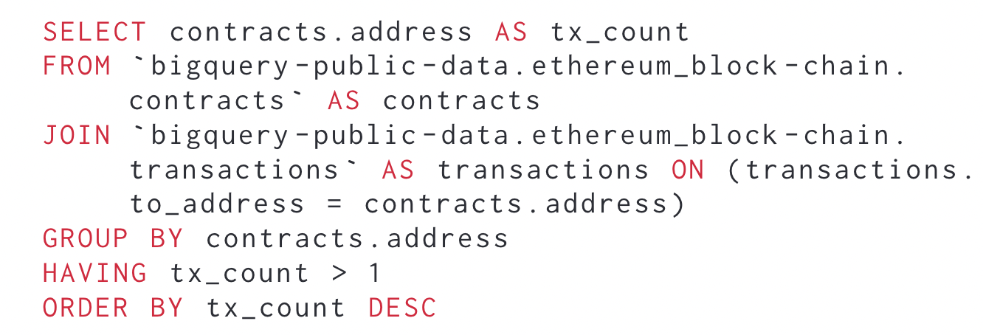
Methodology
Collecting smart contracts from Etherscan
Retrieve the addresses from Google BigQuery
Utilize Crytic-compile to add the metadata to contracts
https://github.com/crytic/crytic-compile
Notes:
In this section I explain the data source, tools used, and process to label the dataset with an example.
We decided to collect smart contracts from Etherscan, which is the largest decentralized platform for Ethereum smart contracts.
All contracts stored on Etherscan are indexed by unique addresses, so we first retrieve the addresses of all contracts that have more than one transaction through Google BigQuery

Slide 39
Methodology
Annotate smart contracts on a rolling-basis
So far, ~7000 annotated smart contracts
Compatibility and compute challenges
Notes:
In this section I explain the data source, tools used, and process to label the dataset with an example.
We decided to collect smart contracts from Etherscan, which is the largest decentralized platform for Ethereum smart contracts.
All contracts stored on Etherscan are indexed by unique addresses, so we first retrieve the addresses of all contracts that have more than one transaction through Google BigQuery

Slide 40
Methodology
Annotate smart contracts on a rolling-basis
So far, ~7000 annotated smart contracts
Compatibility and compute challenges
Notes:
In this section I explain the data source, tools used, and process to label the dataset with an example.
We decided to collect smart contracts from Etherscan, which is the largest decentralized platform for Ethereum smart contracts.
All contracts stored on Etherscan are indexed by unique addresses, so we first retrieve the addresses of all contracts that have more than one transaction through Google BigQuery

Slide 41
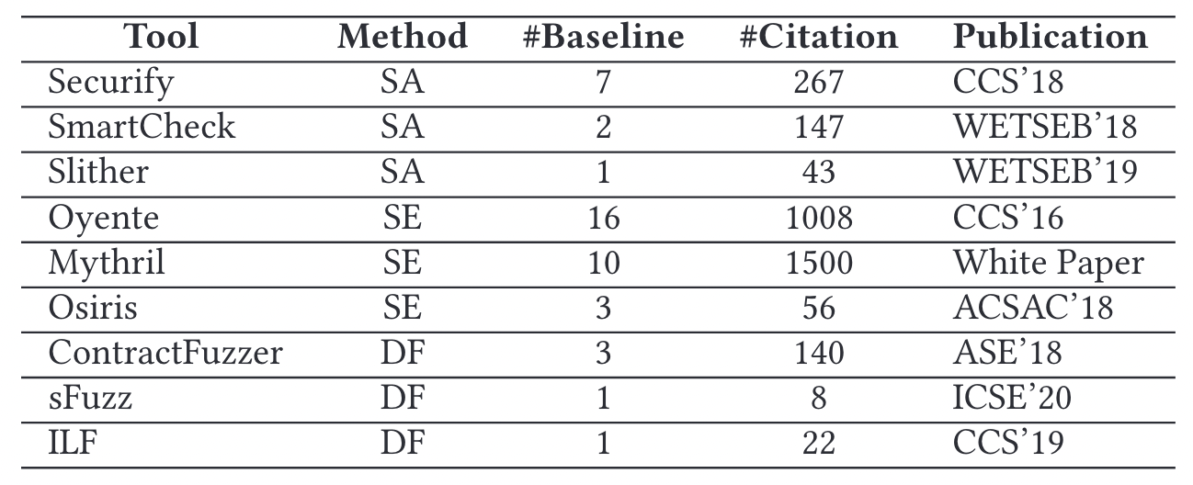
Selecting Candidate Tools
Five most frequently used tools
Slither, Mythril, Oyente, Osiris, SmartCheck
Available and CLI
Compatible input
Only source
Vulnerability Finding
Notes:
Our experiment used five most frequently compared open-source tools, namely Slither, Mythril, Oyente, Osiris, and SmartCheck.
The following points explain the criteria to select the tools as used in the paper by Durieux et. Al:
Available and CLI: The tool is released publicly and has a command-line interface (CLI).
Compatible Input: The tool requires input as Solidity smart contract. We do not consider the tools that require only EVM bytecode.
Only Source: The tool runs on only Solidity source code. We do not consider the tools that require a test suite or smart contract labelled with assertions.
Vulnerability Finding: The tool finds vulnerabilities in smart contracts.
These tools are neither sound nor complete. They can miss vulnerabilities (False Negatives) or detect them when they are not present (False Positives).

Slide 42
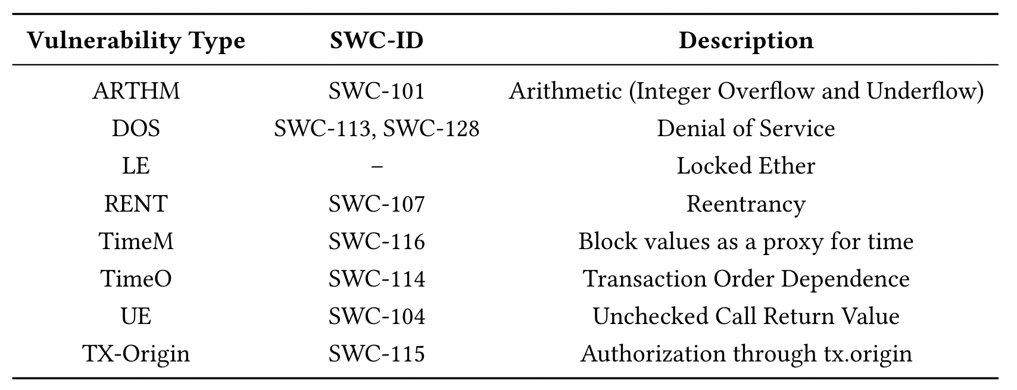
Vulnerabilities
Notes:
Table 1 shows vulnerabilities selected for evaluation. The column “Vulnerability type” indicates the acronym used in the paper for a particular vulnerability, while the column “SWC-ID” shows the ID provided by the SWC Registry 1 for the vulnerability where available. Table 2 shows vulnerabilities supported by selected tools. Symbol ✓indicates that the tool can detect a particular vulnerability, whereas symbol ×indicates that the tool can’t detect the vulnerability. Symbol – indicates that we don’t know whether the tool has detection capability of the particular vulnerability or not. Due to improper documentation of the tool, it is hard to find whether it supports this vulnerability or not.

Slide 43
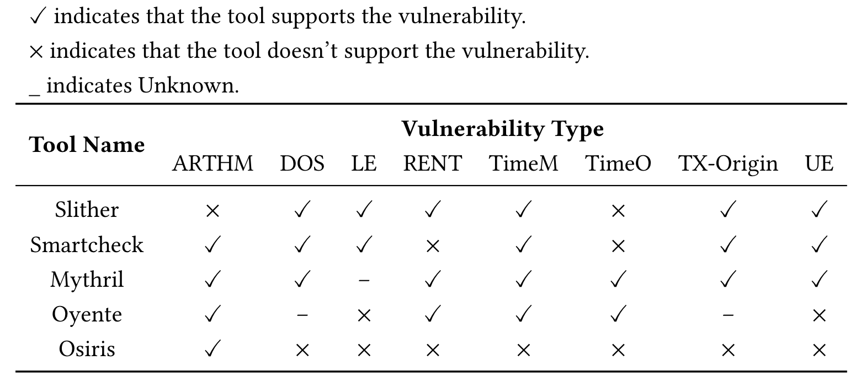
Vulnerabilities
Notes:
Table 1 shows vulnerabilities selected for evaluation. The column “Vulnerability type” indicates the acronym used in the paper for a particular vulnerability, while the column “SWC-ID” shows the ID provided by the SWC Registry 1 for the vulnerability where available. Table 2 shows vulnerabilities supported by selected tools. Symbol ✓indicates that the tool can detect a particular vulnerability, whereas symbol ×indicates that the tool can’t detect the vulnerability. Symbol – indicates that we don’t know whether the tool has detection capability of the particular vulnerability or not. Due to improper documentation of the tool, it is hard to find whether it supports this vulnerability or not.

Slide 44
Vulnerabilities
Five most frequently used tools
Slither, Mythril, Oyente, Osiris, SmartCheck
Available and CLI
Compatible input
Only source
Vulnerability Finding
Notes:
Our experiment used five most frequently compared open-source tools, namely Slither, Mythril, Oyente, Osiris, and SmartCheck.
The following points explain the criteria to select the tools as used in the paper by Durieux et. Al:
Available and CLI: The tool is released publicly and has a command-line interface (CLI).
Compatible Input: The tool requires input as Solidity smart contract. We do not consider the tools that require only EVM bytecode.
Only Source: The tool runs on only Solidity source code. We do not consider the tools that require a test suite or smart contract labelled with assertions.
Vulnerability Finding: The tool finds vulnerabilities in smart contracts.
These tools are neither sound nor complete. They can miss vulnerabilities (False Negatives) or detect them when they are not present (False Positives).

Slide 45
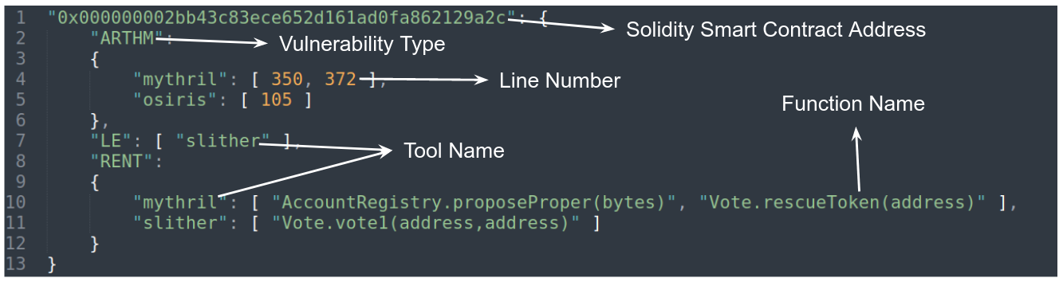
EtherBase
Notes:
EtherBase

Slide 46
EtherBase
Piece of code run on blockchain
Inherits properties of blockchain (e.g., immutability)
Differences between smart contracts (WEB3) and traditional codes (WEB2)
Notes:
EtherBase

Slide 47
EtherBase
Piece of code run on blockchain
Inherits properties of blockchain (e.g., immutability)
Differences between smart contracts (WEB3) and traditional codes (WEB2)
Notes:
EtherBase

Slide 48
EtherBase
Piece of code run on blockchain
Inherits properties of blockchain (e.g., immutability)
Differences between smart contracts (WEB3) and traditional codes (WEB2)
Notes:
EtherBase

Slide 49
EtherBase
Piece of code run on blockchain
Inherits properties of blockchain (e.g., immutability)
Differences between smart contracts (WEB3) and traditional codes (WEB2)
Notes:
EtherBase

Slide 50
EtherBase
Piece of code run on blockchain
Inherits properties of blockchain (e.g., immutability)
Differences between smart contracts (WEB3) and traditional codes (WEB2)
Notes:
Conclusion

Slide 51
Code Similarity in Solidity
Transferring the Structural Embeddings into Ethereum
Notes:
This part is a systemization of knowledge on oracle systems. Oracles are the systems that bring the real-world data into the blockchain

Slide 52
Conclusions
Take-Aways from this thesis
Notes:
In this section I’ll be talking about the conclusion and future work scheduled with regards to this research.

Slide 53
Conclusions
Ever-increasing applications of smart contracts
Security is critical
Notes:
To address the limitations of existing methods for exploring Ethereum, we propose and develop EtherBase, a systematic and high-fidelity data exploration framework which exploits Ethereum block explorers and Ethereum’s internal mechanisms.
EtherBase acquires all historical data on smart contracts and collects ERC20 token activities, thus enabling many new applications.
We demonstrate its usefulness through one out of many application, namely benchmarking the most popular static analysis tools against each other on a selected set of Ethereum smart contracts, which have yielded new insights.
EtherBase and the collected data will be released after the paper is published.
Smart contracts have a wide range of applications, involving a large amount of digital assets.
For developers and transaction participants, security is critical.
Though various testing tools for smart contracts have emerged endlessly, the lack of a unified evaluation standard makes it difficult to evaluate their performance in a scientific, fair and comprehensive way.
For assisting follow-up researchers in carrying out comparative experiments more reasonably, we collect 46,186 diversified contracts, propose a systematic evaluation process and perform extensive experiments.
We recommend that the evaluation process should take the following factors into consideration:
a set of diverse test suites; (b) a unified execution environment with suitable runtime parameters; (c) more quantitative and multi-dimensional performance metrics.
he first is to better combine dynamic and static methods to reduce false positives. The second is to develop more advanced integration models that can give full play to the strengths of different tools.
I hope this thesis can provide ideas and references to follow-up researchers, and help them develop more reliable, powerful and friendly testing tools.

Slide 54
Conclusions
Proposed a new baseline approach for code similarity in Solidity
Evaluated on internal audit datasets

Slide 55
Conclusions
Proposed a new baseline approach for code similarity in Solidity
Evaluated on internal audit datasets
More representative and advanced models developed in the past year

Slide 56
Conclusions
Proposed a new baseline approach for code similarity in Solidity
Evaluated on internal audit datasets
More representative and advances models developed in the past year
Lack of high-quality datasets

Slide 57
Conclusions
Proposed a new baseline approach for code similarity in Solidity
Evaluated on internal audit datasets
More representative and advances models developed in the past year
Lack of high-quality datasets
More high-quality datasets are needed to further the SOTA in research

Slide 58

Any Questions?
sina.pilehchiha@mail.concordia.ca
Notes:
Thank you for listening to this presentation and I'll be happy to answer any questions.

